Slide 1
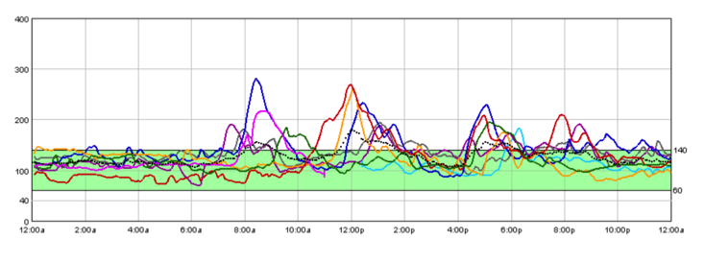
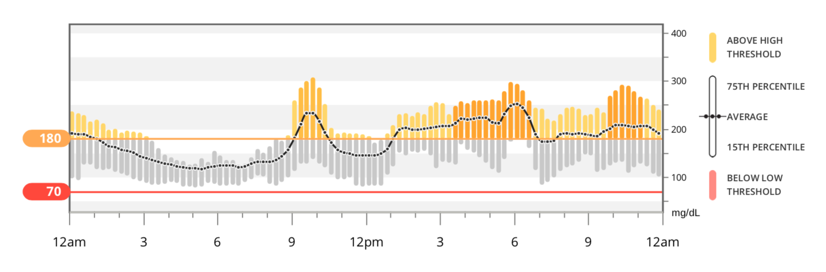



An R Package for Analysis of Continuous Glucose Monitor Data
Tim Vigers, Christine L. Chan, Janet Snell-Bergeon, Petter Bjørnstad, Philip S. Zeitler, Gregory Forlenza, Laura Pyle
Objective
To develop a standardized, free, open-source method for data management and analysis of continuous glucose monitor (CGM) data, including calculation of the key metrics recommended in the International Consensus on Use of Continuous Glucose Monitoring, and graphical tools similar to the Ambulatory Glucose Profile (AGP).
Methods
We wrote a package in the freely available statistical programming language R (R Foundation for Statistical Computing, Vienna, Austria). Summary variables and aggregate daily overlays were compared to proprietary CGM software using clinically collected data from multiple CGM devices. Data were not cleaned prior to analysis. A subset of the comparisons is shown here. Proprietary software does not calculate MAGE or other more complex variables, so these were not compared.
Calculated Variables
Percent CGM wear
Sensor glucose: average, standard deviation, coefficient of variation, minimum, maximum, and quartiles Variables above for daytime and nighttime periods
Estimated A1c (eA1c)
Glucose management indicator (GMI)
Excursions, minutes spent, and time spent above/below threshold
Minutes and percent time in range (70 – 180 mg/dL)
Area under the curve (using the trapezoidal rule)
Mean amplitude of glycemic excursions (MAGE)
J index
Continuous overall net glycemic action (CONGA)
Mean of daily differences (MODD)
Low blood glucose index (LBGI)
High blood glucose index (HBGI)
Comparisons to Proprietary Devices
iPro 2
Dexcom Clarity
 | cgmanalysis | iPro
# Sensor Values | 2000 | 2000
Highest | 282 | 282
Lowest | 70 | 70
Average | 126.87 | 127
Standard Dev | 30.79 | 31
# High Excursions | 31 | 32
# Low Excursions | 0 | 0
% Time Above 140 | 24.85 | 24
% Time Below 60 | 0 | 0
 | cgmanalysis | Dexcom Clarity
Average | 175.6790404 | 176
Standard Dev | 67.09674726 | 68
Time in Range | 55.65656566 | 56
Results
Summary variables calculated by our package compare well to those generated by various CGM software, and our functions increase the number and complexity of summary measures readily available to clinicians and researchers.
Conclusions
Consistent handling of CGM data using our R package will allow for collaboration between research groups and contribute to a better understanding of free-living glucose patterns.
Download the Package Here or on CRAN (“cgmanalysis”):

